Slide 1
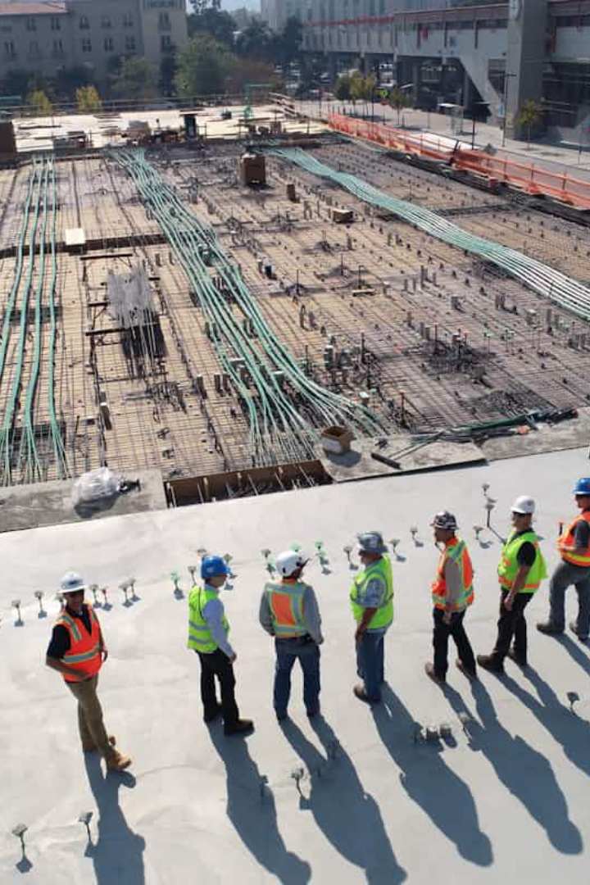

Nanotechnology in Construction: Building the Future
Nanotechnology, manipulating materials at an atomic scale, is set to revolutionise construction. It addresses key challenges like durability, sustainability, and performance. This global market is projected to reach £3.4 billion by 2025.

Slide 2

Cement and Concrete Enhancement
Nano-silica boosts concrete strength by 25%. Carbon nanotubes increase tensile strength by 40%. Nano-titanium dioxide offers self-cleaning properties. It also purifies air, reducing NOx by 30%.
The Burj Khalifa in Dubai used nano-enhanced concrete.
This provided superior durability in extreme conditions.

Slide 3
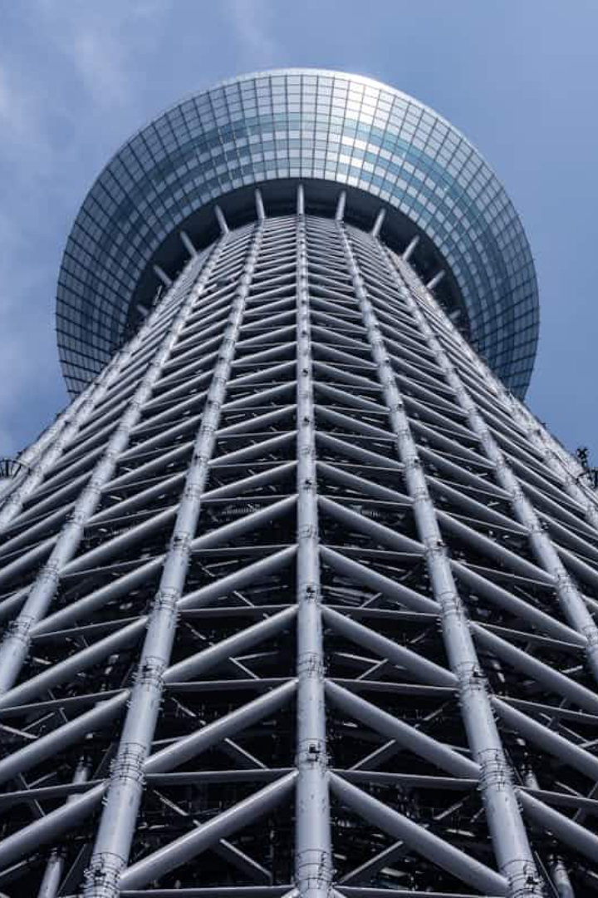



Steel and Metal Protection
Corrosion Resistance
Nano-coatings extend lifespan by 50%. They provide superior protection against corrosion.
Self-Healing
These coatings repair micro-cracks automatically. This significantly reduces maintenance costs.
Anti-Fouling
They prevent marine biofouling. This is vital for offshore structures.
The Thames Barrier in London uses nano-engineered steel. This enhances its flood protection capabilities.

Slide 4

Insulation and Energy Efficiency
Aerogels
Aerogels have ultra-low thermal conductivity. They reduce energy consumption by 40%.
Vacuum Insulation Panels
VIPs feature nano-porous cores. They provide superior insulation performance.
Nano-enhanced PCMs
These materials regulate temperature. They reduce peak energy demand efficiently.
The Crystal building in London uses advanced insulation. This minimises its overall energy consumption.

Slide 5

Smart and Multifunctional Materials
Self-Sensing Concrete
Self-Healing Polymers
Embedded nano-sensors monitor stress. They also measure strain within the concrete.
These polymers autonomously repair damage. This extends the structural lifespan significantly.
Chromogenic Materials
They change colour in response to stimuli. This includes temperature and light.
The "Smart Bridge" in Leeds has embedded sensors. These monitor its structural health in real-time.

Slide 6
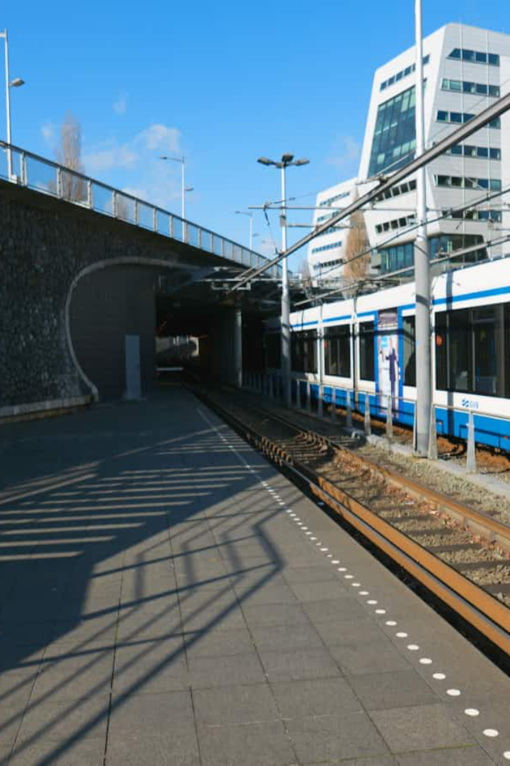



Applications in Infrastructure
Bridges
Nano-enhanced concrete extends lifespan by 30 years. It also significantly reduces maintenance.
Tunnels
Nano-coatings provide waterproof protection. They also offer fire-resistant properties.
Roads
Nano-modified asphalt improves durability. It also significantly reduces cracking.
The Tsing Ma Bridge in Hong Kong uses nano-enhanced paint. This protects against corrosion effectively.

Slide 7






Environmental Benefits and Sustainability
Improved Durability
Longer lifespan reduces waste. This lessens environmental impact.
Reduced Carbon Footprint
Lower cement consumption aids sustainability. Energy-efficient materials also contribute.
Air and Water Purification
Photocatalytic nano-materials clean pollutants. They contribute to cleaner environments.
Eco-cement with nano-additives reduces CO2 emissions by 20%. This highlights nanotechnology's sustainable potential.

Slide 8




Challenges and Future Outlook
High Initial Costs
Nano-materials can be quite expensive. This poses a barrier to widespread adoption.
Scalability and Standardisation
Mass production and quality control are essential. These aspects require further development.
Health and Safety
Potential toxicity of nano-particles requires ongoing research. Safety protocols are crucial.
Future trends include self-assembling structures. Also, 3D-printed nano-materials show promise.

